Slide 2
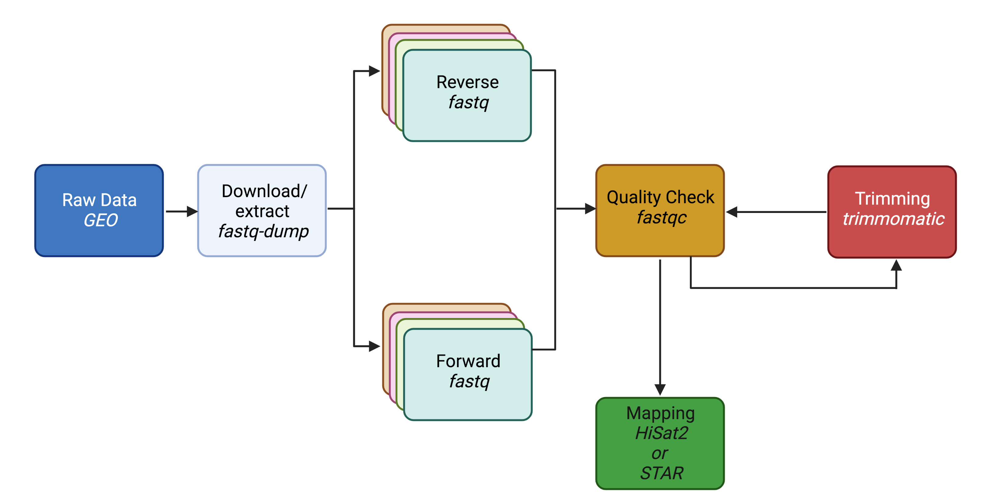
Overview

Slide 3
Past Topics
This Weeks’ Topics

Slide 4
FASTQC recap

Slide 5
Step 1: FASTQC
Two basic questions of QC
How successful was the actual sequencing?
High base call confidence <30 phred score
Did the library prep generate a faithful representation of the DNA/RNA molecules in the sample?
No contaminations (rRNA, adapters, primers, etc.)
No bias towards fragments of certain GC contents/sizes

Slide 6
Assignment overview
Homework #8
(due 3/1)
Homework #7
(due 2/23)
Homework #9
(due before Spring break)

Slide 7
Trimming

Slide 8
Step 2: Clean the FASTQ files
Raw reads may suffer from the following:
Presence of adaptors
Low quality reads
Or other issues that result in low base call
Trimming is optional
Avoid aggressive clipping as this could cause miss-mapping

Slide 9
Why optional?
Modern “local aligners” like STAR, BWA-MEM, HISAT2, will “soft-clip” non-matching sequences
Other pseudo-aligners like Salmon or Kallisto will not have a problem with reads containing adapter sequences
However, if the data is being used for variant analysis or genome assembly, reads should be trimmed

Slide 10
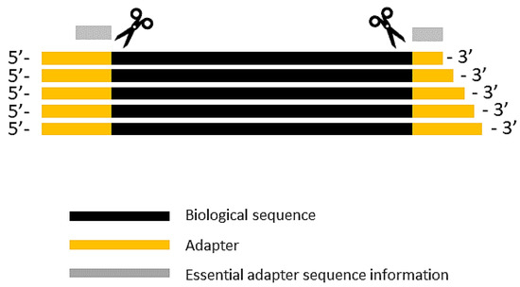
Common programs used for trimming
Preprocessing of FASTQ can be performed by a variety of programs
fastp
Trimmomatic
Trim galore
Cutadapt

Slide 11
How would you run a program on the VACC?
Install it in your personal VACC account and then be able to call it (sratoolkit)
Or load it from the shared computing cluster using module package (fastqc)

Slide 12
Use module to load
module avail – to see what programs are available
module load trimmomatic-0.38-gcc-7.3.0-jwjzei2
Use tab completion!

Slide 13
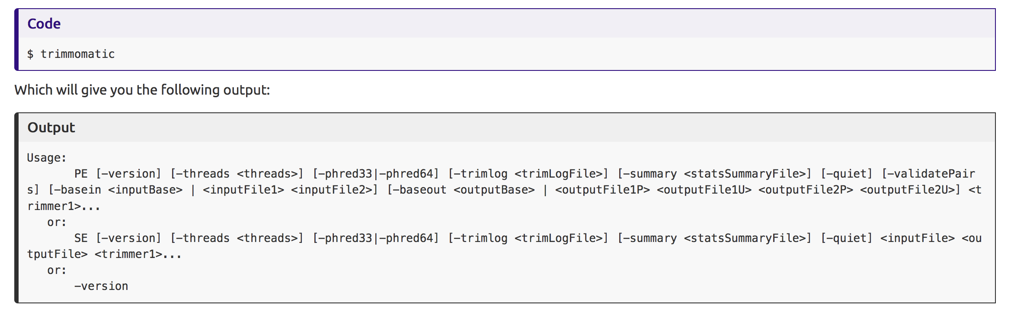
Usage:
Paired-end
single-end

Slide 14
Typical command
trimmomatic input.fastq.gz output.trim.fastq.gz ILLUMINACLIP:~/software/Trimmomatic-0.36/adapters/pick_adapters LEADING:3 TRAILING:1 SLIDINGWINDOW:4:20 MINLEN:60
https://github.com/timflutre/trimmomatic/tree/master/adapters
ILLUMINACLIP: Cut adapter and other illumina-specific sequences from the read.
LEADING: Cut bases off the start of a read, if below a threshold quality
TRAILING: Cut bases off the end of a read, if below a threshold quality
SLIDINGWINDOW: Perform a sliding window trimming, cutting once the average quality within the window falls below a threshold.
Drop reads below the 60 bases long (MINLEN:60)

Slide 15
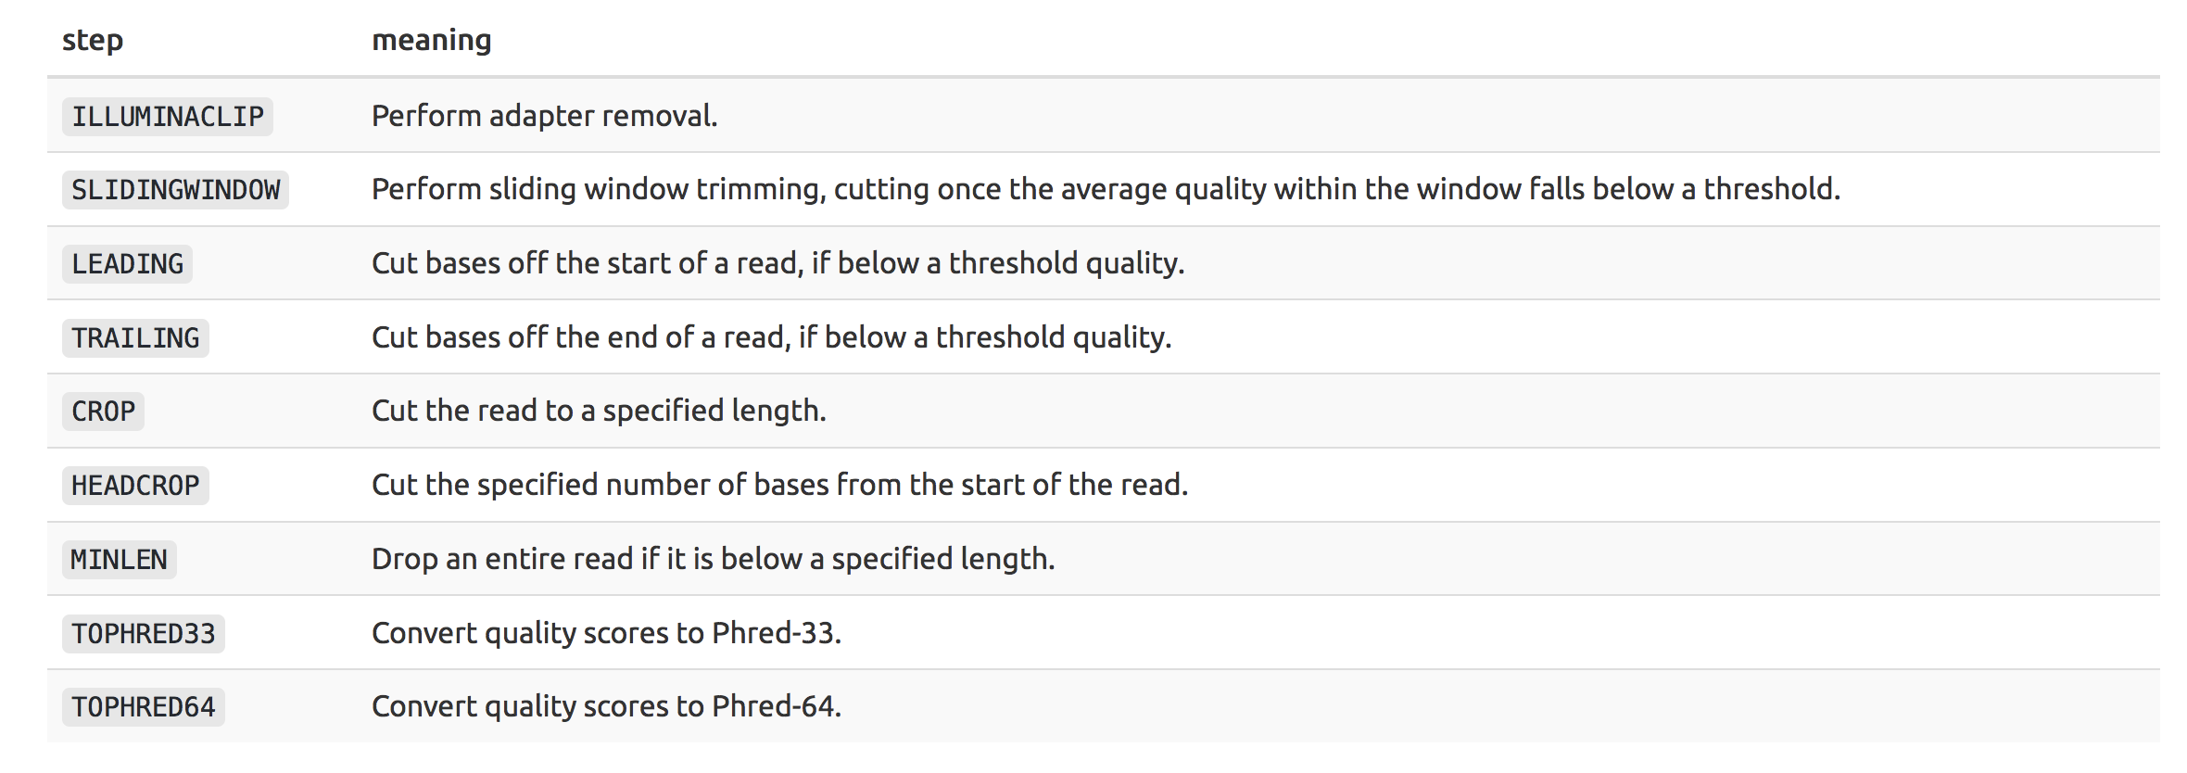
Command parameters

Slide 16
Output
SRR258199.fastq.qz
SRR258199.trim.fastq.qz
Should be smaller, because you have removed reads
trimmomatic input.fastq.gz output.trim.fastq.gz ILLUMINACLIP:~/software/Trimmomatic-0.36/adapters/pick_adapters LEADING:3 TRAILING:1 SLIDINGWINDOW:4:20 MINLEN:60

Slide 17
Once trimmed, need to run fastqc again!
If bad…

Slide 18
Mapping to Reference

Slide 19
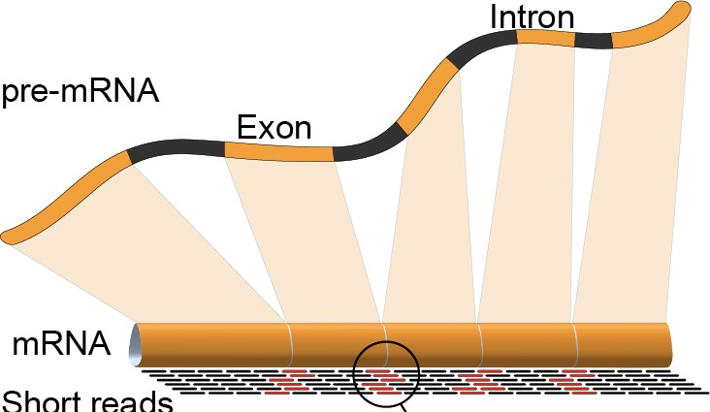
Read alignment / “mapping”
Notes:
During library preparation, DNA/RNA are fragmented: the fragments from the entire genome/transcriptome become completely mixed-up. The goal of read alignment/mapping is to put things back into place i.e. determine which read goes where in the genome

Slide 20
Mapping
counts.matrix
1
mapping
(trimmed FASTQ)
GENOME
SAM to BAM
TRANSCRIPTIOME
counts.matrix
2

Slide 21
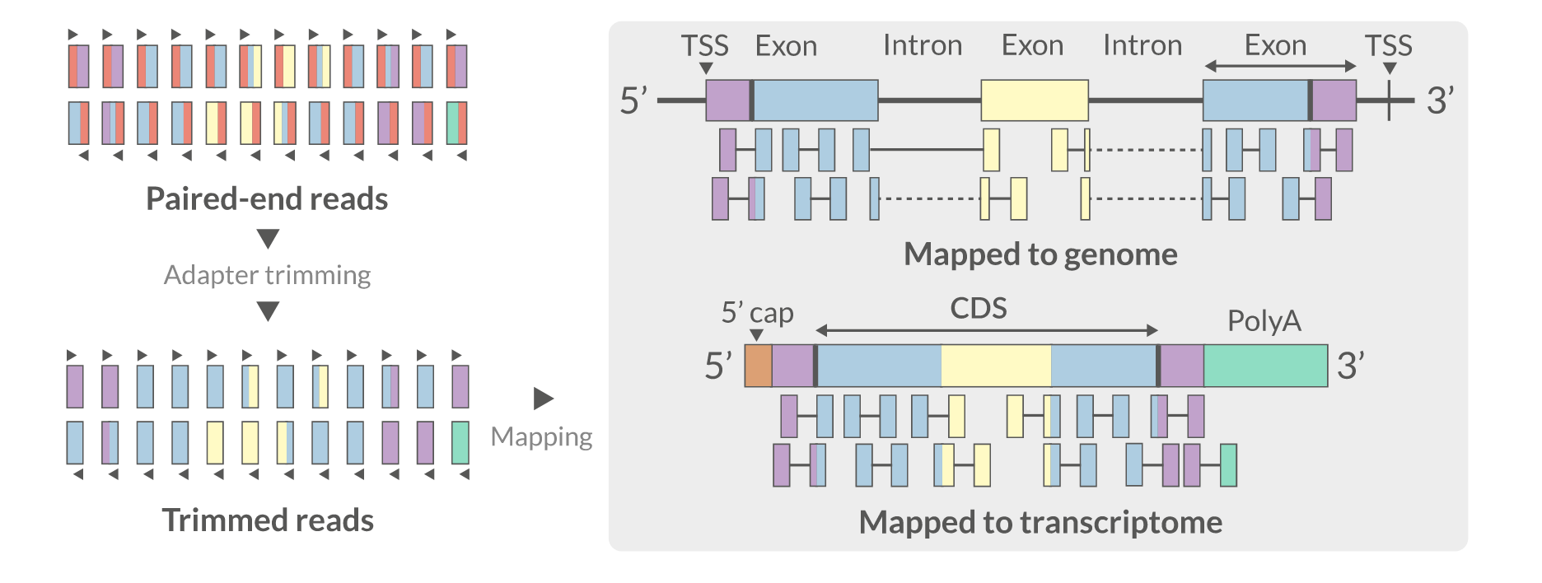
Mapping
Red = adapter
Red is gone!

Slide 22
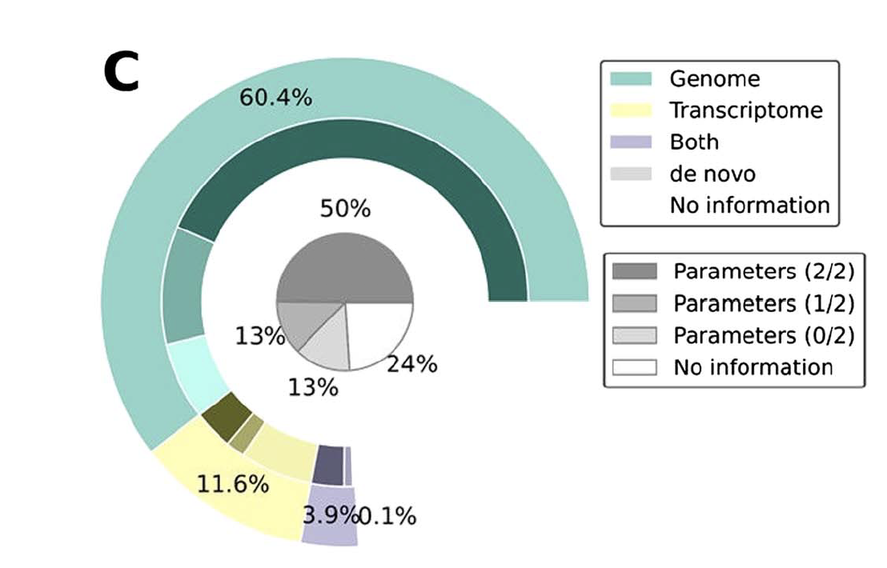
What the scientific community does Genome vs Transcriptome
Simoneau et al. 2021

Slide 23
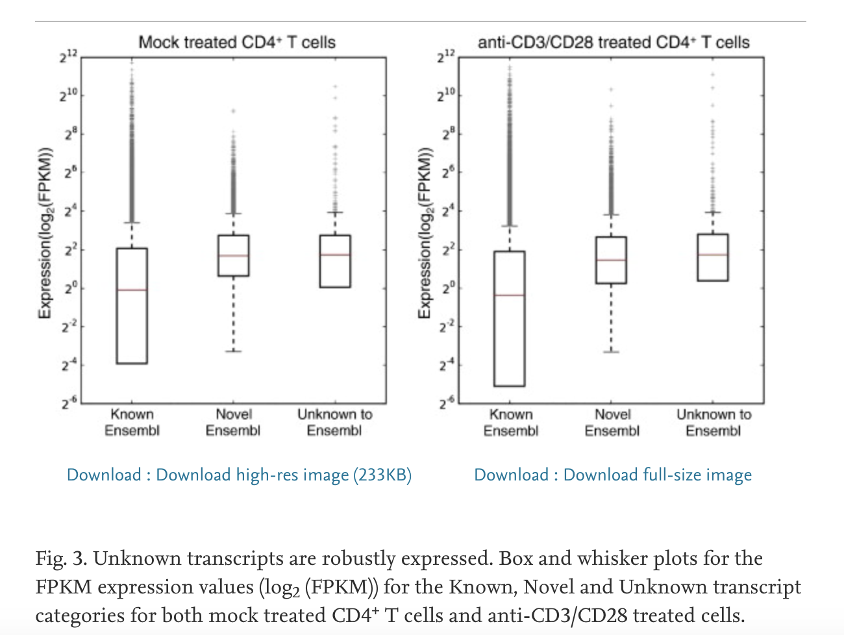
Genome
Transcriptome
Creation of BAM- visualization file
70-90% of RNA-seq reads to map to human genome
Transcript discovery & counting
Mice - Transcripts unknown to Ensembl represent as much as 5% of the transcripts that are robustly expressed
BAM not created
Mapping is only as good as the reference – slightly lower reads mapped
Does not allow for transcript discovery
Hutchins et al.
Notes:
Mapping solely to the reference transcriptome of a known species precludes the discovery of new, unannotated transcripts and focuses the analysis on quantification alone.

Slide 24
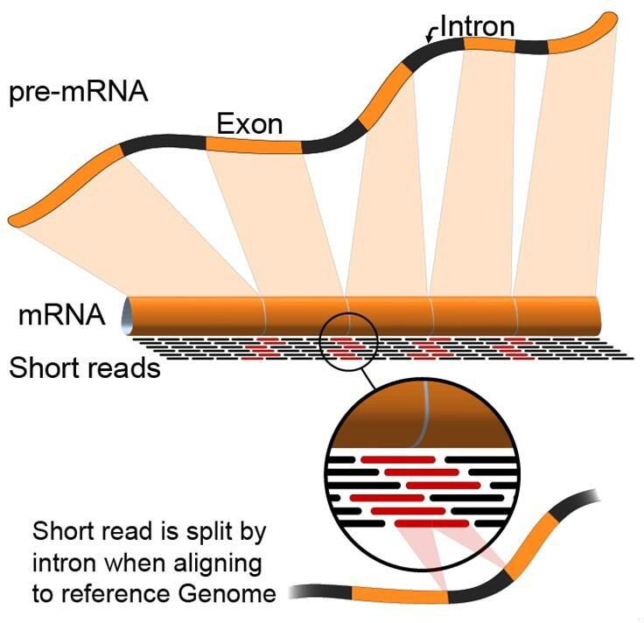
What is the challenge when mapping to the genome?

Slide 25






Short reads can cause ambiguity in mapping different splicing isoforms
Gene
Isoform 1
Isoform 2
Reads

Slide 26
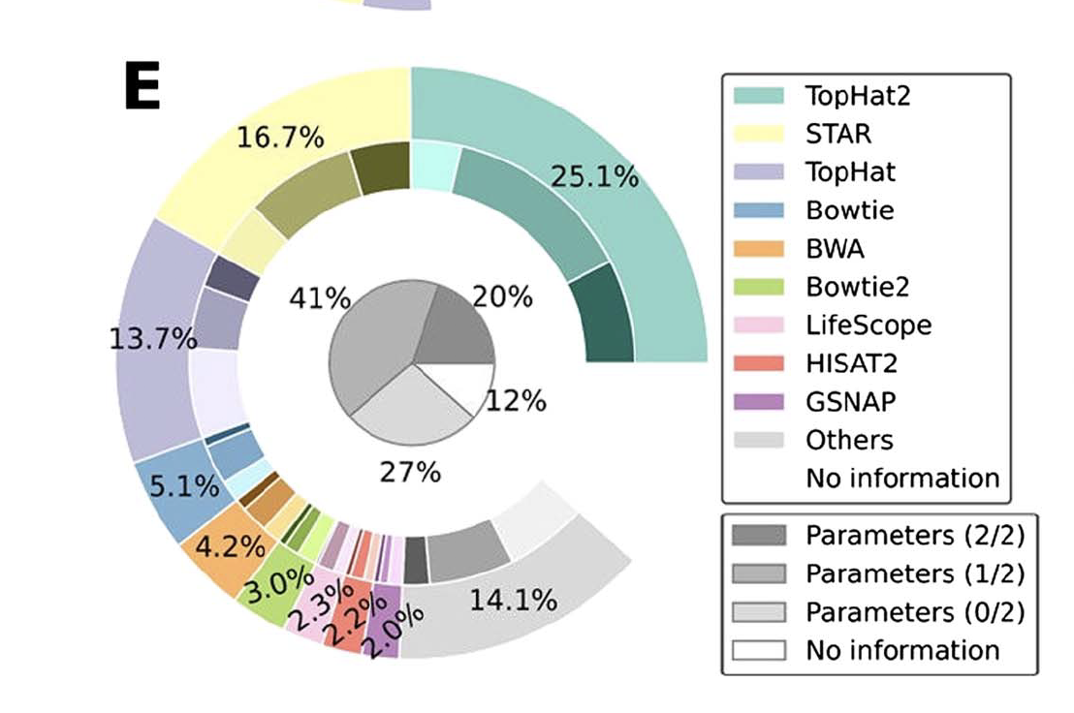
Programs available
Genome
Transcriptome
TopHat
STAR
Bowtie2
BWA
HiSat2
Salmon
Kallisto
Sailfish

Slide 27
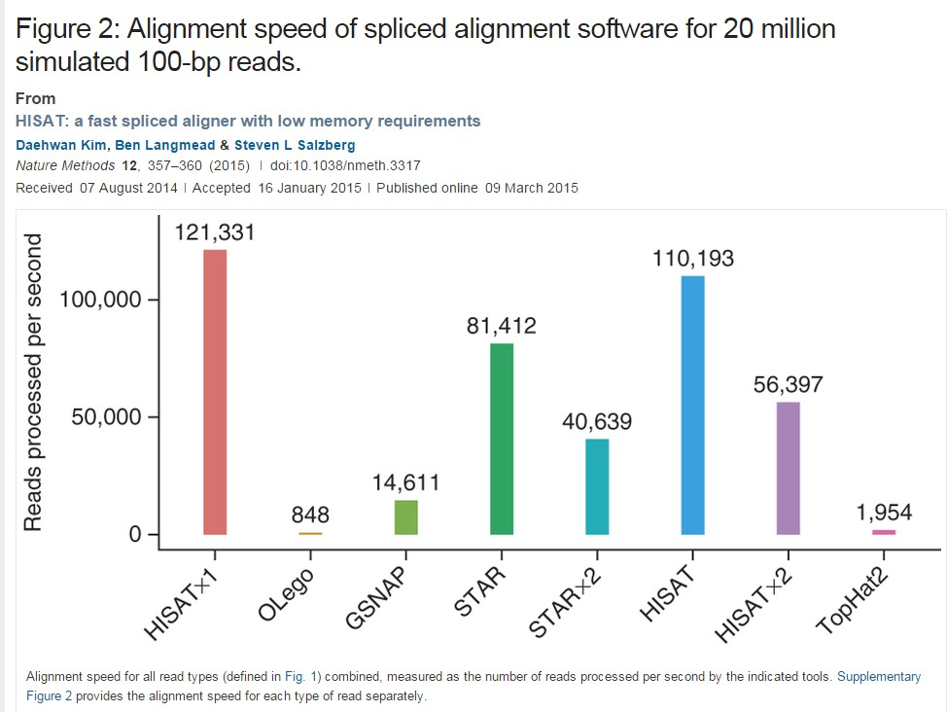
Speed
Alignment is the most computationally expensive step of the pipeline

Slide 28
Genomic Reference
The FASTQ needs to aligned to a reference genome (FASTA)
In addition, to quantify the number of reads which align to different genome features this requires knowing where known genes and exons are located (GTF,GFF file)
Genomic coordinates of various genomic features
Always use the same biological database for all reference data.

Slide 29
There are a few sources available:
General biological databases: Ensembl, GENCODE, and UCSC
Organism-specific biological databases: Wormbase, Flybase, CryptoDB, etc. (often updated more frequently, so may be more comprehensive)

Slide 30
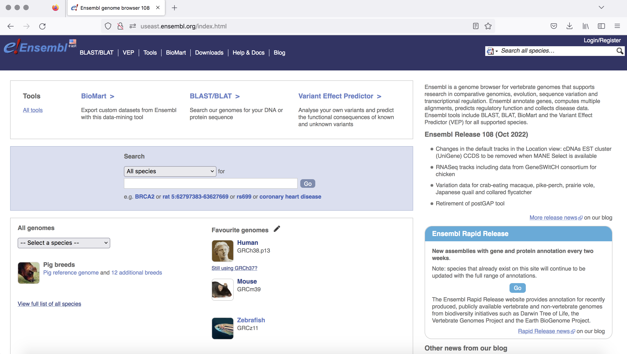
Ensembl

Slide 31
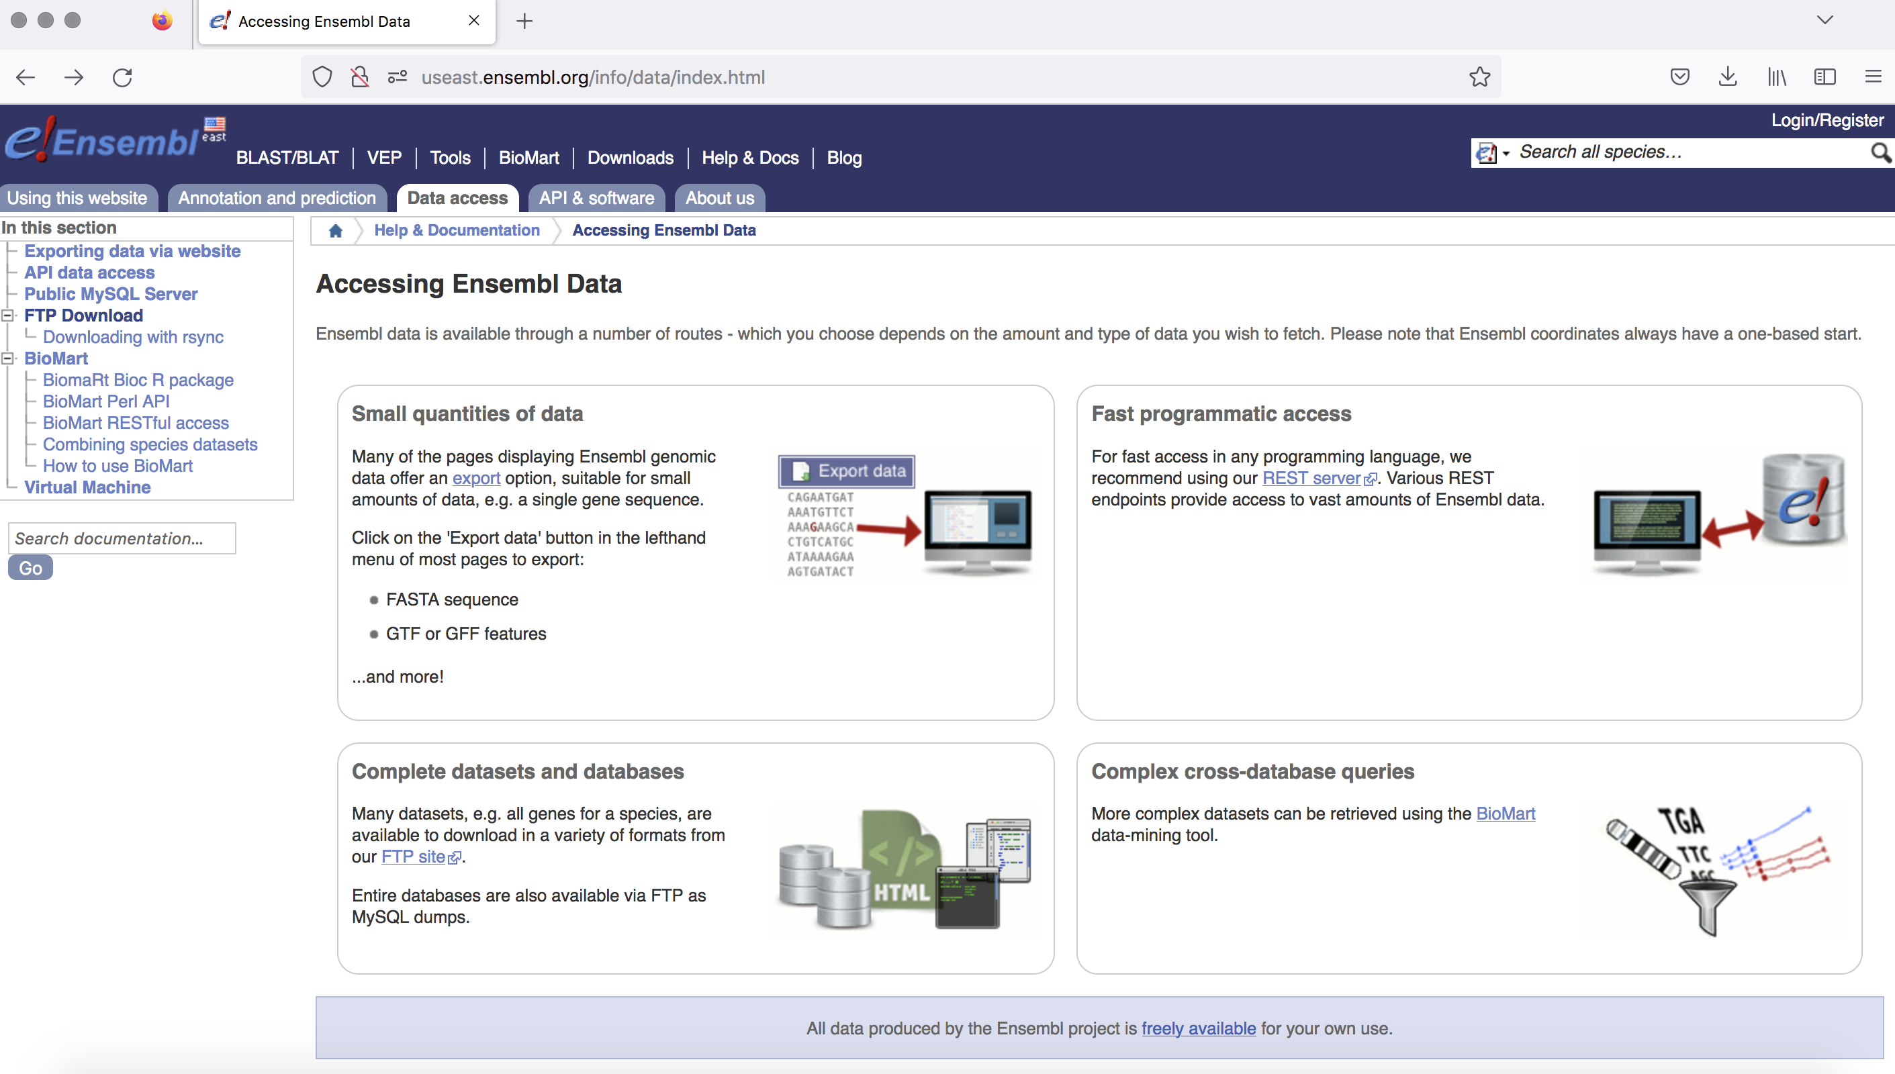

Slide 32
FASTA file
>1 dna_sm:chromosome chromosome:GRCm38:1:1:195471971:1 REF TTCTGTTTCTATTTTGTGGTTACTTTGAGGAGAGTTGGAATTAGGTCTTCTTTGAAGGTC TGGTAGAACTCTGCATTAAACCCATCTGGTCCTGGGCTTTTTTTTTTTTTTTTTTTTTTT TTTGGGTGGGAGACTATTGATGACTGCCTCTATTTCTTTAGGGGAAATGGGACTTTTAGT
...
ID & Misc.Infos Sequence
(ctd.)
>10 dna_sm:chromosome chromosome:GRCm38:10:1:130694993:1 REF CCGAATGGCAGAGAAACACCTGAATAAAATGTTCAACATCCTTAATCATCAGGGAAATGC | ID 2 Sequence | 2
AAATCAAAACAACACTGAGATTCCACTTCACTCCAGTTAGAATGGCTAAGATCAAAAACT
CAGGTGACAACAGATGTTGGCGAGGATGTGGAGAAAGGGGAACACTCCTCCATTGTTGGT
...
>11 dna_sm:chromosome chromosome:GRCm38:11:1:122082543:1 REF | ID 3
ACATTTTTCACGTTTTTCACTGTTTCTCGCCATATTCCAAGTCTTACAGTGTGTGTTTCT | Sequence | 3
TATTTTGTAGGTTTTTTCAGTGTTTGTGGCCATATTCTAGGTCTTAACAGGGGAGTTTTT
AATTTTACTCACTGGTCAGTTTTCTTGCCATAATCCTGGTCCTACCATAGGTGTGTCTCA
...

Slide 33
GTF files
Chrom
Feature type
Start
End Strand
Metadata
1 | ensembl | gene | 4430189 | 4450423 . + | . | gene_id | "ENSACAG00000011126"; | gene_name "TMEM1
1 | ensembl | transcript | 4430189 | 4450423 . + | . | gene_id | "ENSACAG00000011126"; | transcript_id
1 | ensembl | exon | 4430189 | 4430804 . + | . | gene_id | "ENSACAG00000011126"; | transcript_id
1 | ensembl | CDS | 4430503 | 4430804 . + | 0 | gene_id | "ENSACAG00000011126"; | transcript_id
1 | ensembl | start_codon | 4430503 | 4430505 . + | 0 | gene_id | "ENSACAG00000011126"; | transcript_id
1 | ensembl | exon | 4439303 | 4439440 . + | . | gene_id | "ENSACAG00000011126"; | transcript_id
1 | ensembl | CDS | 4439303 | 4439440 . + | 1 | gene_id | "ENSACAG00000011126"; | transcript_id
1 | ensembl | exon | 4443852 | 4443930 . + | . | gene_id | "ENSACAG00000011126"; | transcript_id
1 | ensembl | CDS | 4443852 | 4443930 . + | 1 | gene_id | "ENSACAG00000011126"; | transcript_id
1 | ensembl | exon | 4445846 | 4450423 . + | . | gene_id | "ENSACAG00000011126"; | transcript_id
1 | ensembl | CDS | 4445846 | 4446022 . + | 0 | gene_id | "ENSACAG00000011126"; | transcript_id
1 | ensembl | stop_codon | 4446023 | 4446025 . + | 0 | gene_id | "ENSACAG00000011126"; | transcript_id
1 | ensembl | five_prime_utr | 4430189 | 4430502 . + | . | gene_id | "ENSACAG00000011126"; | transcript_id
1 | ensembl | three_prime_utr | 4446026 | 4450423 . + | . | gene_id | "ENSACAG00000011126"; | transcript_id
Tab-delimited text files

Slide 34
HiSat2 pipeline
Reference FastA files
Indexed Genome
Reference GTF Models
Reads
(fastq)
Yes
Maps with known junctions
Report
Pool of known splice junctions
Yes
Add
Maps convincingly with novel junction?
Report
No
Discard
Notes:
Discovery of new junctions depends a lot on where the junction is in the read.
50/50 easy to discover
90/10 probably impossible
Can do 1 or 2 pass processing. 2 pass is more complete - uses first pass just to find junctions but is slow.
In practise 1 pass is fine and you hardly lose anything.

Slide 35
Example of code using hisat2
hisat2-build *.fasta <name>
hisat2 \
-p 8 \
-x {GENOME} \
-1 {SAMPLE}_unmapped_R1_001.fastq.gz \
-2 {SAMPLE}_unmapped_R2_001.fastq.gz \
-S {SAMPLE}.sam

Slide 36
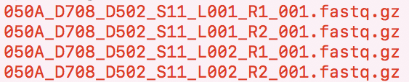
FASTQ files are huge!
zipped-up
Notice, its fastq.gz
No need to decompress it
Any programs can use the .gz file as input
We need to merge these files by lane – not by read

Slide 37
cat command
Cat(concatenate) command is frequently used in Linux
One major function is to merge the contents of multiple files
cat filename1 filename2 > merged_file
Merge read1
Merge read 2
From 4 files to 2 files
Check size with disk usage command

Slide 38
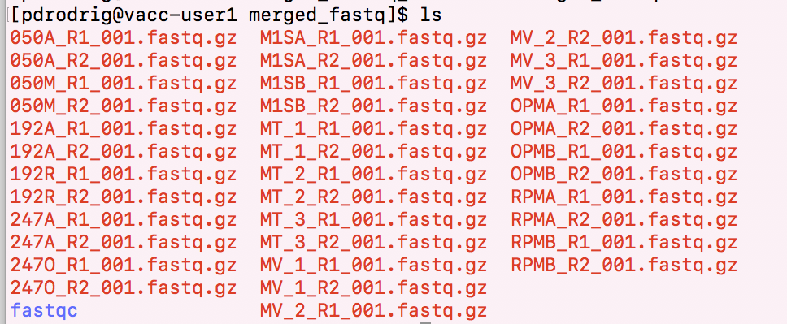
results of cat

